Slide 1
Yahoo News Comments Classifier
NLP-Based Classification of Yahoo
Comments for Enhanced Content Moderation
Presented by
Harshit Koncharla (01243405)
Hemant Kumar(01243485)
Sairaj Kuchana(01243581)

Slide 2
Agenda
Introduction
Problem Statement
Proposed Solution & Methodology
Dataset
Pre-Processing of data
Model Description
GPT 3.5
Llama 2
Google Gemini
LSTM
Evaluation Metrics & Results
Findings & Conclusions
Application & Future Work

Slide 3
Introduction
The surge of social media and online forums has transformed communication dynamics, with comments serving as crucial elements for user engagement.
However, moderating user-generated content poses challenges due to the decentralized nature of these platforms.
To address this, comment categorization using natural language processing offers a scalable solution to classify comments and ensure the safety of online communities.

Slide 4
Problem Statement
Proliferation of harmful or inappropriate comments due to platform anonymity.
Negative impact of inconsistent and biased categorization on user experience.
Manual categorization is limited by time constraints, scalability issues, and biases.
Need for an automated solution to overcome these challenges.

Slide 5
Proposed Solution & Methodology
We are introducing a comment categorization tool as a promising approach to automate content moderation.
We aim to presents a methodology tailored for Yahoo comments, aiming to deploy a robust system capable of categorizing comments into six distinct categories (Humour, Spam, Neutral, Consolidating, Ideological, Abusive), thereby contributing to the advancement of automated content moderation.

Slide 6
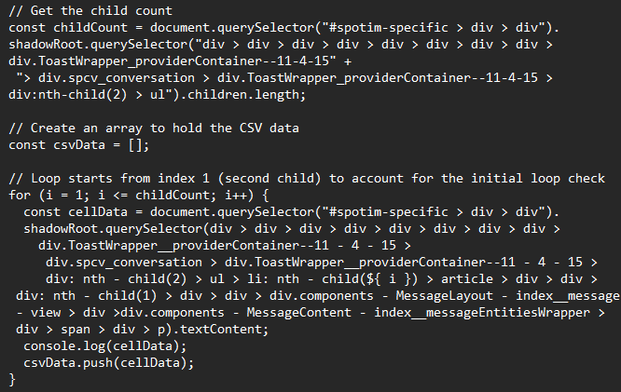
Dataset
Utilization of web scraping techniques for dataset collection.
Classification of comments into six categories: Ideological, Humorous, Consolidating, Abusive, Spam, and Neutral.
Training dataset consisting of 20x6 comments categorized across multiple topics.

Slide 7
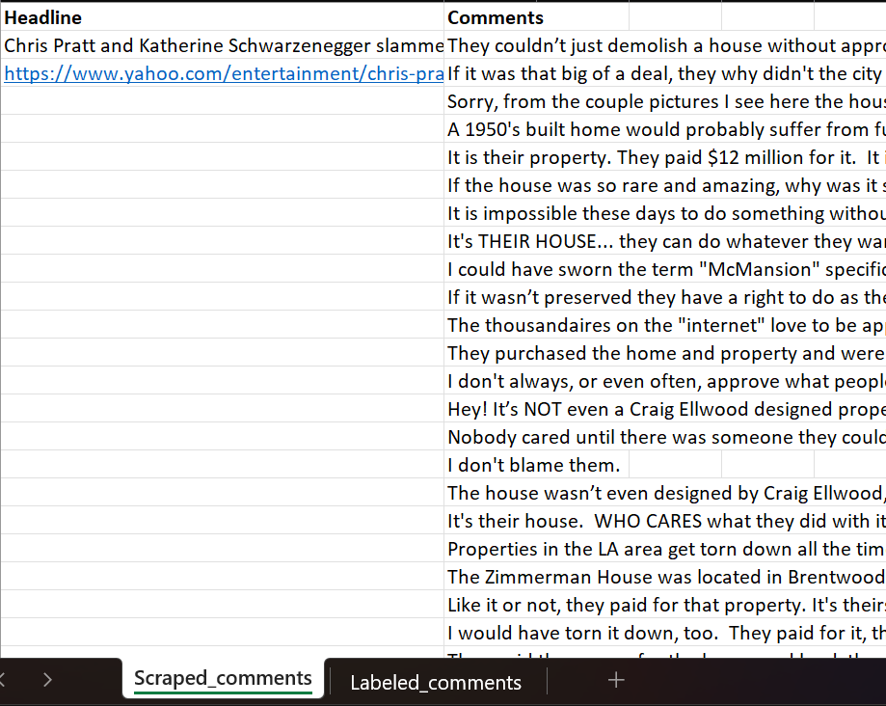
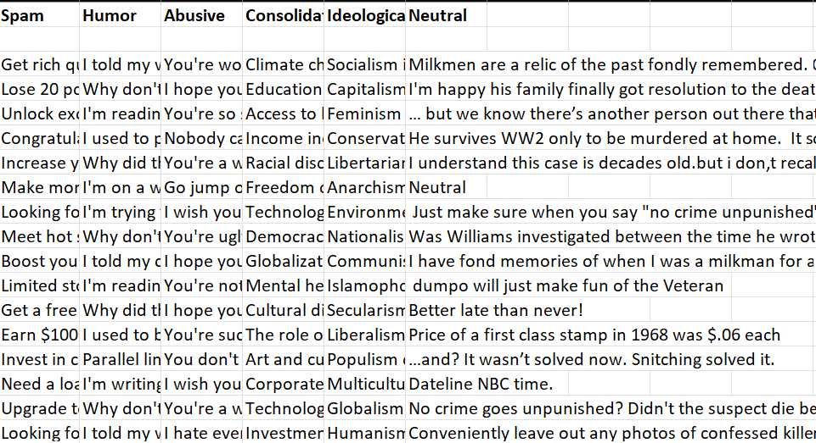
Dataset Cntd.

Slide 8
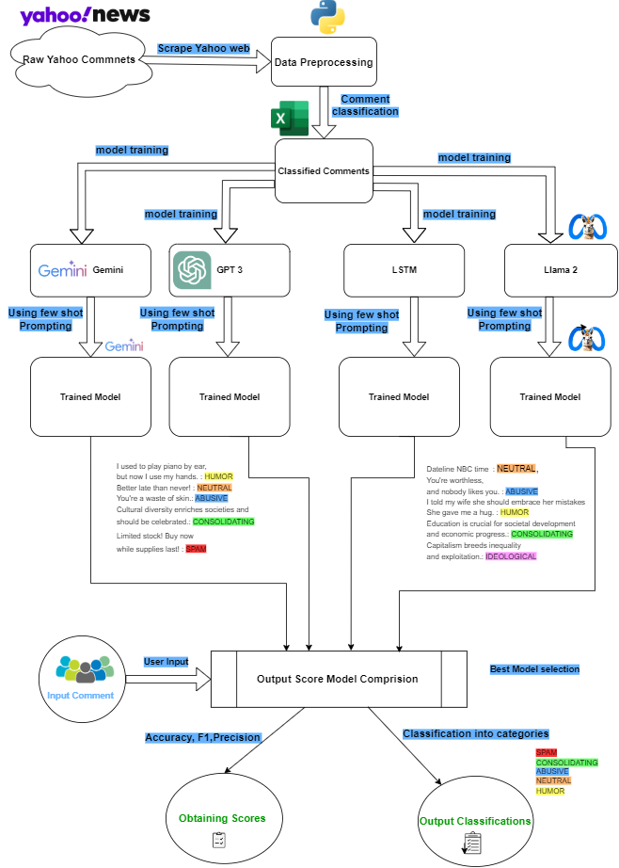
Model Description
Comparison of state-of-the-art models: GPT-3.5, Google Gemini, LLAMA2 and LSTM.
Consideration of model performance metrics including precision, recall, F1 score, and accuracy.
Evaluation of Model considering the best accuracy from all 4 techniques.

Slide 9
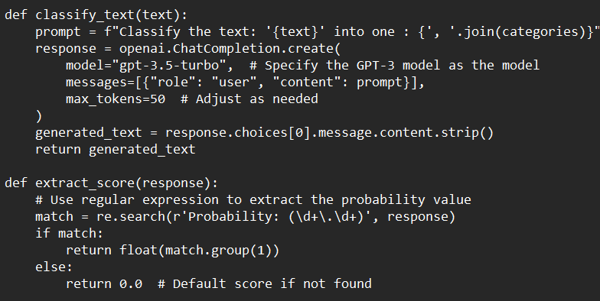
GPT-3.5
Bidirectional Context Awareness
Versatility
Large-Scale Language Understanding

Slide 10
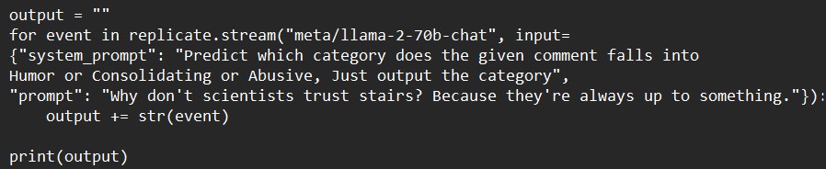
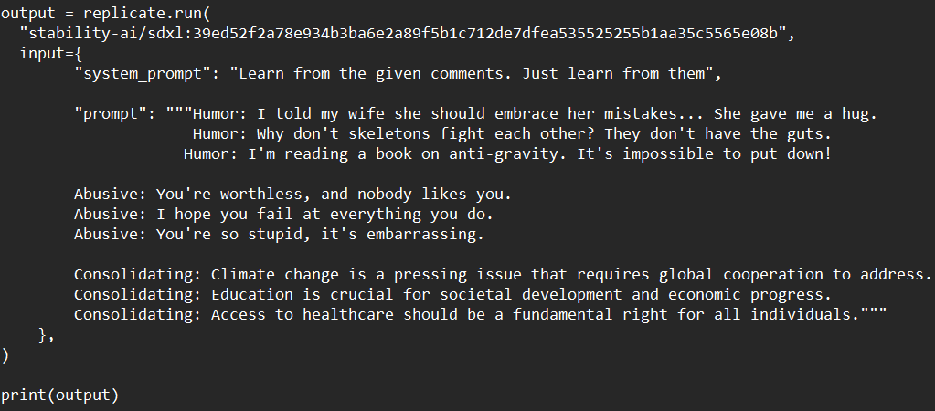
Llama 2
Transformer Architecture
Semantic Coherence
Long-Range Dependencies

Slide 11
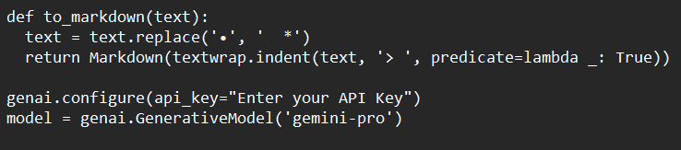
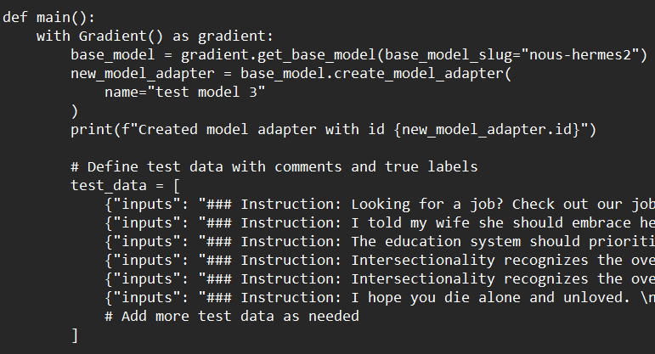
Google Gemini
Graph Neural Networks
Comprehensive Understanding
Semantic Association Extraction

Slide 12
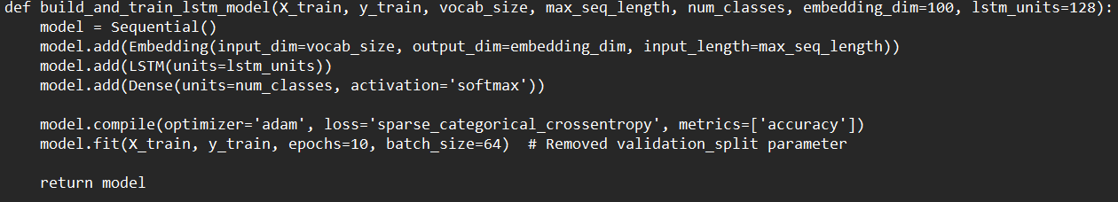
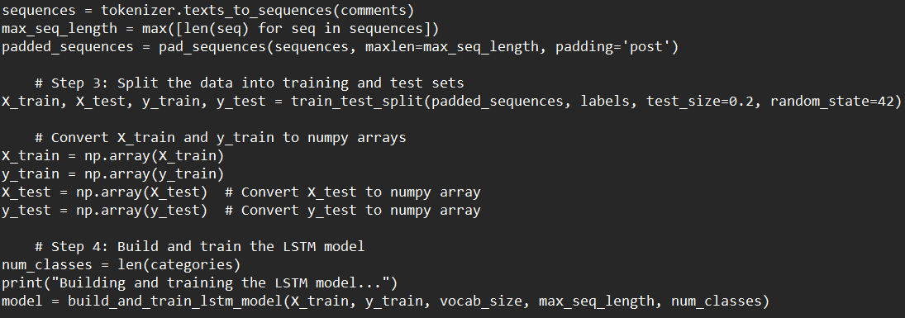
LSTM
Sequential Data Processing
Context Understanding
Long-Term Dependencies

Slide 13
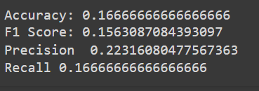


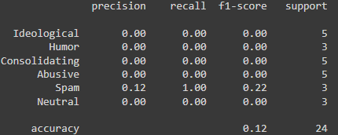
Evaluation Metrics & Results
GPT 3.5 : Llama 2:
Gemini: LSTM:

Slide 14
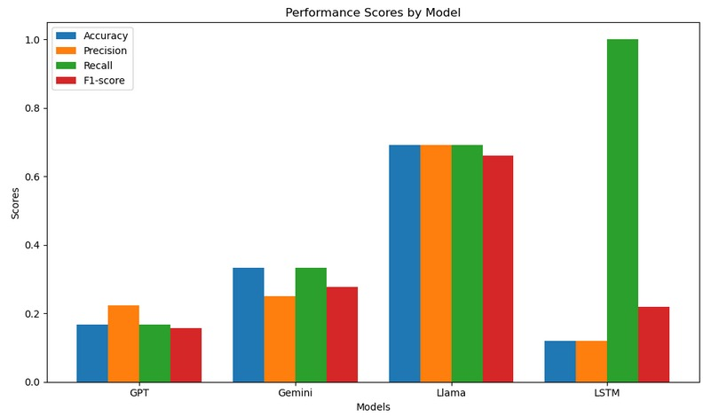
Findings & Conclusions
Llama excels with high accuracy, precision, and F1-score.
LSTM achieves perfect recall but suffers from low precision.
Gemini demonstrates decent performance but falls short in precision.
Overall, Llama emerges as the best-performing model, balancing precision and recall effectively.

Slide 15
Application & Future Work
Potential applications of the developed comment classification model in automated content moderation.
Exploration of future research directions, such as enhancing model interpretability and generalizability.
Consideration of scalability and adaptability of the model to other online platforms beyond Yahoo News.
Importance of ongoing research and development to address evolving challenges in online content moderation.
we envision building a Chrome extension based on our implementation, allowing users to seamlessly integrate our comment categorization tool into their browsing experience

Slide 16
References
Ona De Gibert, Naiara Perez, Aitor Garc ́ıa-Pablos, and Montse Cuadros. Hate speech dataset from a white supremacy forum.arXiv preprint arXiv:1809.04444, 2018.
Ahlam Alrehili, Automatic Hate Speech Detection on Social Media: A Brief Survey, https://ieeexplore.ieee.org/document/9035228
Anna Wolters, Kilian Müller, Dennis M. Riehle Incremental Machine Learning for Text Classification in Comment Moderation Systems, https://link.springer.com/chapter/10.1007/978-3-031-18253-2_10
Ms. Shivani Kadam, Ms. Komal Ghatage, Mr. Aadesh Chaugule, Prof. J. W. Bakal Comment Toxicity Tracker Using NLP with Emphasis on Machine Learning Algorithms, https://www.ijraset.com/best-journal/comment-toxicity-tracker-using-nlp-with-emphasis-on-machine-learning-algorithms
D Manikalyan, TOXIC COMMENT CLASSIFICATION USING BI-LSTM, ttps://ijsrem.com/download/toxic-comment-classification-using-bi-lstm/
David Allenotor, David Oyemade, A Classification Model Based on Machine Learning for Detecting Racist Comments on Social Media Platforms, https://www.isteams.net/_files/ugd/185b0a_a1fe7284a51e4453a94f1b5f8b5c1179.pdf
R. Rooba A.R.Karthekeyan, Youtube Comment Feature Selection And Classification Using Fused Machine Learning, https://www.propulsiontechjournal.com/index.php/journal/article/view/982
Julian Risch and Ralf Krestel. Toxic comment detection in online discussions. Deep learning-based approaches for sentiment analysis, pages 85–109, 2020

Slide 17
Thank You

